Slide 1


NAVAL ARCHITECTURE
A presentation for students, teachers & parents about studying and careers in Naval Architecture in UK

Slide 2


  Who am I
  Current role
  Responsibilities in the role
  What is a Naval Architect
  Why is it important
  Who am I​
  Current role​
  Responsibilities in the role​
  What is a Naval Architect​
  Why is it important​
  Naval Architecture & Marine Engineering – University of Strathclyde​
  Naval Architecture & Ocean Engineering​
  Naval Architecture & High-Performance vehicles ​
  Naval Architecture & Marine Engineering – Newcastle University​
  Naval Architecture & Marine Engineering – University of Plymouth​
  Who can be a Naval Architect​
  GSCE​
  A – Levels​
  Other routes to Naval Architecture​
  Get engaged​
  It is a field with a future ​
  Q&A​
  GCSE
  A – Levels
  University
  Other routes to Naval Architecture
  Get engaged
  A field with a future
  Q&A
CONTENT

Slide 3
WHO AM I?
JOB
STUDY
OTHER
OTHER
Notes:
Photos & text to be amended accordingly by the presenter
Outline
What is your name
What have you done up until now and how did you reach your current role
Where do you work and what do you do

Slide 4
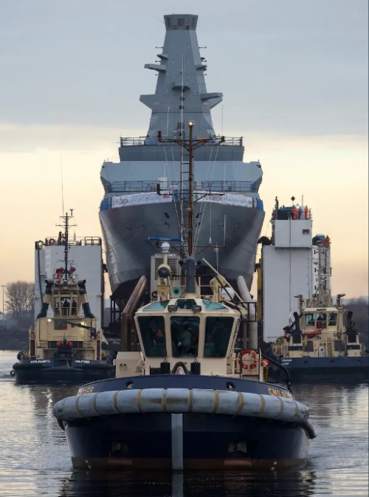
CURRENT ROLE
  A combination of hands-on experience & theory
  Specific department & in-depth immersion to the discipline
  Extensive past experience among colleagues
  Critical thinking required
  People with different educational backgrounds can work in the Industry
  Easy to approach colleagues regardless of their position within the company
  Professional Development & soft skills
Notes:
Photos & text to be amended accordingly by the presenter
Depict snapshots of your everyday work that will stimulate the students and will prompt questions
Do you have an office job or a more hands on one?
What fascinates you the most in your current role?

Slide 5
Sort time limits between tasks/rapid changes
Hands on experience
Responsibility/ accountability
RESPONSIBILITIES IN THE ROLE
High levels of discipline
Project that affects people’s lives
Team focused
Flexible solutions delivered quickly
Theory and Practice
Exciting projects
Notes:
Photos & text to be amended accordingly by the presenter
Include photos of yourself at work, if possible

Slide 6
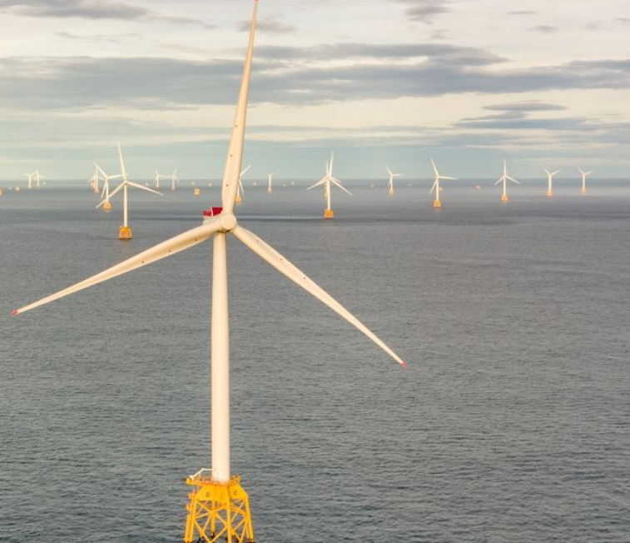
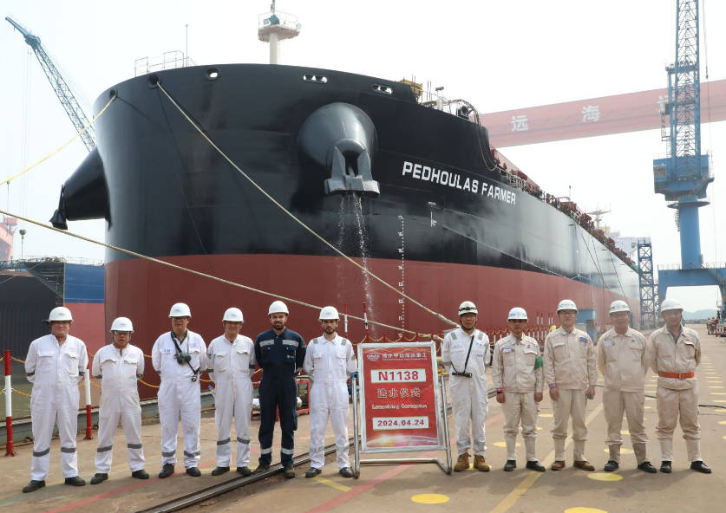
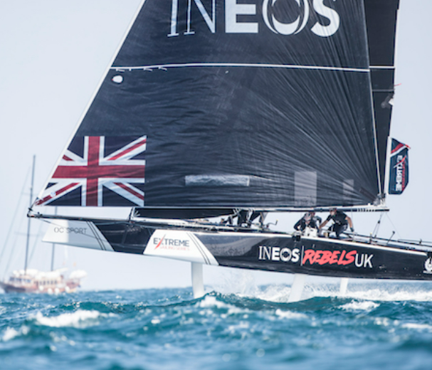
WHAT IS A NAVAL ARCHITECT
Ocean Engineering
Marine Engineering
High-Performance vehicles
Notes:
Naval architects are engineers that design, construct, refit and repair marine vessels and offshore structures including passenger and cargo ships, submarines, high-speed ferries and catamarans, tugs, boats, yachts and oil rigs
Provide an outline of the different fields in Naval Architecture
What do you do at each one?
Sources
National Careers Service: https://nationalcareers.service.gov.uk/job-profiles/naval-architect
Safebulkers: https://www.linkedin.com/company/safebulkers-inc/
SSE wind farm: https://www.sserenewables.com/offshore-wind/
Lloyds: Extreme Sailing action from Barcelona in 2018

Slide 7
  Around 90% of traded goods are transported globally over the waves
  Ocean engineering allows offshore renewable, oil and gas structures to operate
  Leisure craft (sailing and motorboats), and boat racing are designed and built by naval architects (high-performance stream)
WHY IS IT IMPORTANT
Notes:
Outline the importance of Naval Architects based on the points presented in this slide

Slide 8
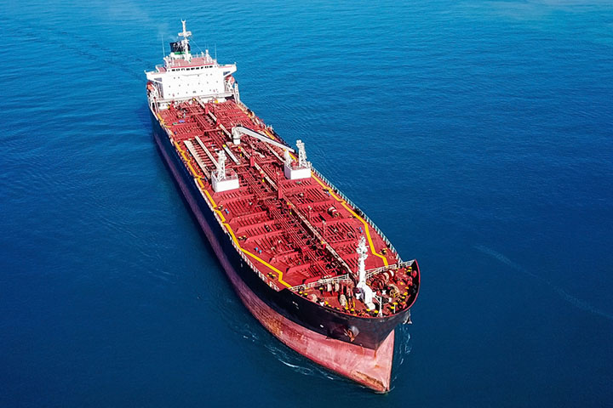
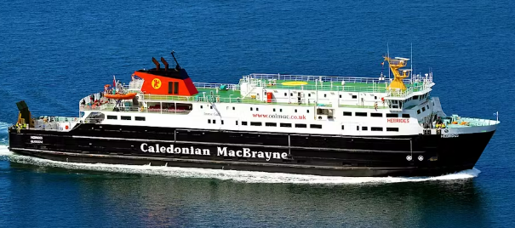


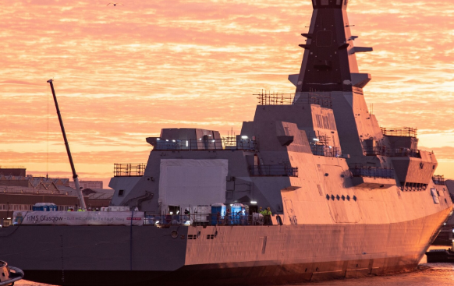
UNIVERSITY COURSES
There are a range of courses offered at different universities which specialise in slightly different aspects of Naval Architecture.
Universities you can study at include:
  Newcastle University
  University of Southampton
  University of Strathclyde
  University College London
  University of Plymouth
Notes:
Describe the different ships that a marine engineer can work on
Mention that they make sure they work and in case of failure, they inspect them and they come up with a solution to fix the problem
Provide information about their magnitude, or give personal examples/photos of how big they are
Can ask students if they know how big a containership is.
Sources
Royal Caribbean cruise ships from newest to oldest — a complete list: https://thepointsguy.com/guide/royal-caribbean-cruise-ships-newest-oldest/
Calmac ferry boat: https://www.calmac.co.uk/
Tanker: https://www.kongsberg.com/maritime/ship-types/tanker/
Maersk containership: https://www.reuters.com/business/maersk-sends-two-us-flagged-container-ships-through-red-sea-2024-01-16/
Type 26: https://www.forces.net/services/navy/new-type-26-frigate-hms-glasgow-successfully-enters-water

Slide 9
NAVAL ARCHITECTURE & MARINE ENGINEERING​
University of Strathclyde​
  Naval architects and marine engineers deal with the world’s largest moving structures and most powerful vehicles​
  Responsible for the design and maintenance of merchant ships able to carry and transport variety of cargo​
  Cruise ships, ferry boats, tankers, cargo ships, containerships, naval ships
Notes:
Describe the different ships that a marine engineer can work on
Mention that they make sure they work and in case of failure, they inspect them and they come up with a solution to fix the problem
Provide information about their magnitude, or give personal examples/photos of how big they are
Can ask students if they know how big a containership is.
Sources
Royal Caribbean cruise ships from newest to oldest — a complete list: https://thepointsguy.com/guide/royal-caribbean-cruise-ships-newest-oldest/
Calmac ferry boat: https://www.calmac.co.uk/
Tanker: https://www.kongsberg.com/maritime/ship-types/tanker/
Maersk containership: https://www.reuters.com/business/maersk-sends-two-us-flagged-container-ships-through-red-sea-2024-01-16/
Type 26: https://www.forces.net/services/navy/new-type-26-frigate-hms-glasgow-successfully-enters-water

Slide 10


  Naval architects and ocean engineers work with oil and gas, but also offshore renewable energy from wind, waves, and tidal currents.​
  Ocean engineering deals with the technical aspects of fixed and floating marine structures and systems related to harnessing ocean resources​
  Offshore renewable industry is full of opportunities for naval architects​
NAVAL ARCHITECTURE & OCEAN ENGINEERING​
Notes:
Briefly mention aspects that students should be interested in to choose this career
Sources
Strength Analysis results 32000 DWT Bulk Carrier: http://www.mesh.com.tr/strength-analyses.html
NAVAL ARCHITECTS and their Career Paths: https://www.linkedin.com/pulse/naval-architects-career-paths-jason-tay/
https://www.sva-potsdam.de/en/towing-tank/

Slide 11
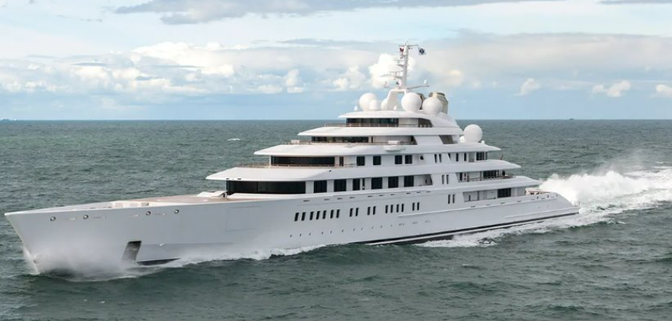

NAVAL ARCHITECTURE & HIGH-PERFORMANCE VEHICLES​
  Naval architects within this field design and build lighter, stronger and faster vehicles ​
  Skills of ship design, construction, operation and maintenance​
  Advanced material and technologies are used ​

Slide 12
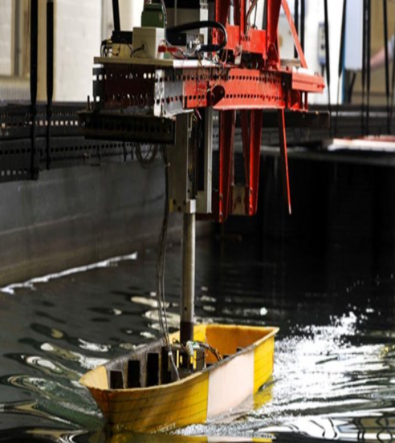
NAVAL ARCHITECTURE & MARINE ENGINEERING​
Newcastle University​
The following terminology is provided by the Newcastle University:​
Naval Architecture​
  Focuses on the advanced structural and hydrodynamic analysis of ships and small craft.​
Marine Engineering​
  Explores key aspects of power transmission, systems and digitalisation of ship machinery.​
Subsea Engineering​
  Learn about offshore support systems for operation in harsh maritime environments​
Offshore Renewables​
  Study the complex dynamics of offshore energy harvesting systems and infrastructure

Slide 13
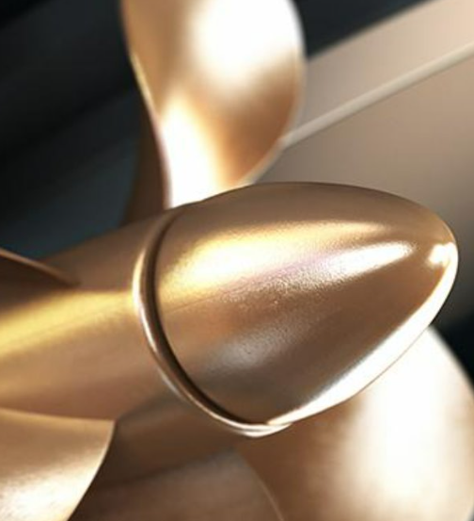
NAVAL ARCHITECTURE & MARINE ENGINEERING​
University of Plymouth
The following terminology is provided by the University of Plymouth:​
Marine technologists are engineers focused on engineering for life at sea. As problem solvers, engineers design, create and use tools in every industry from nanotech to agritech.​
In year 4, you have the option to choose a specialist 'with composites' pathway, as one will be able to study the design and manufacture of specialist materials​

Slide 14
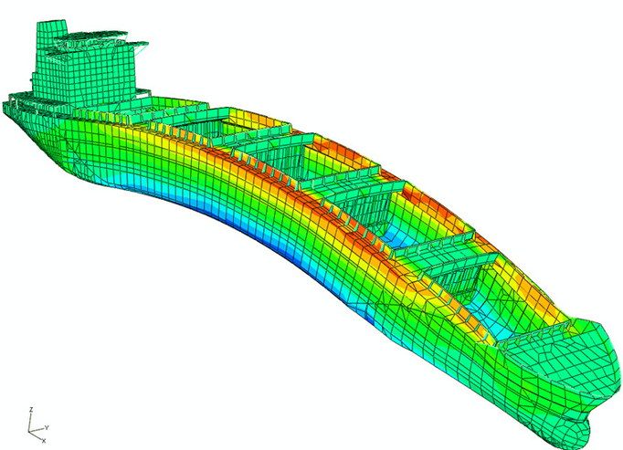
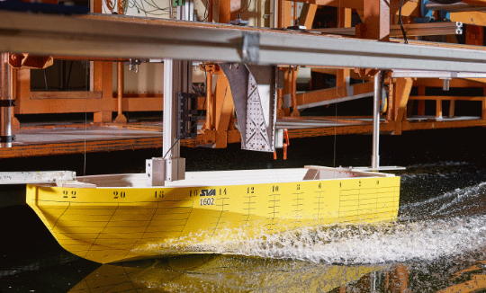
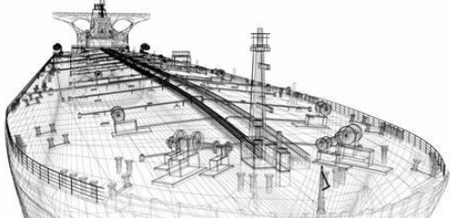
You can be a Naval Architect
If you are interested in:
  Maths and Science
  Innovation and creativity
  Engineering and Technologies
  Design
  Theoretical as well as practical application of your knowledge
  Solving problems
WHO CAN BE A NAVAL ARCHITECT
Notes:
Briefly mention aspects that students should be interested in to choose this career
Sources
Strength Analysis results 32000 DWT Bulk Carrier: http://www.mesh.com.tr/strength-analyses.html
NAVAL ARCHITECTS and their Career Paths: https://www.linkedin.com/pulse/naval-architects-career-paths-jason-tay/
https://www.sva-potsdam.de/en/towing-tank/

Slide 15
A combination of subjects will be required. A general guide can be found below:
  Mathematics: Essential for understanding the complex calculations and problem-solving required in naval architecture.
  Physics: Important for grasping the principles of mechanics, fluid dynamics, and materials science, all of which are crucial in naval architecture.
  English Language: Good communication skills are important for writing reports and documenting research.
  Design and Technology: Provides foundational knowledge in materials and design processes, which can be helpful.
GCSE
Notes:
To pursue a degree in naval architecture at a university in the UK, students typically need to focus on a combination of core and specific subjects during their GCSE studies

Slide 16
A - LEVELS
A combination of subjects will be required. A general guide can be found below:
  Mathematics: A critical subject for naval architecture, as it underpins many of the calculations and technical analyses you'll need to perform.
  Physics: Essential for understanding the principles of forces, mechanics, and fluid dynamics, all of which are crucial in the field of naval architecture.
  Further Mathematics (optional but advantageous): While not always required, it can provide a deeper mathematical background that is useful for more complex problems in naval architecture.
  Design and Technology (optional but useful): Offers insight into materials and design processes, which can be relevant to the practical aspects of naval architecture.
  Engineering (if available): Provides a broader understanding of engineering principles and applications, which can complement the study of naval architecture.

Slide 17


OTHER ROUTES TO NAVAL ARCHITECTURE
  Foundation Degrees and Foundation Years
  Vocational and BTEC Qualifications
  Higher National Certificates (HNC) and Diplomas (HND)
  Apprenticeships
  Access to Higher Education Courses
  International Baccalaureate (IB)
  University Transfer and Mature Entry
Notes:
Foundation Year in Engineering or Science: Some universities offer a foundation year designed to prepare students for undergraduate studies in engineering
This can be a suitable option if you don’t meet the standard entry requirements but are passionate about naval architecture.
Apprenticeships: While not specifically focused on naval architecture, this route can lead to further opportunities and specialized study in naval architecture later on.
Vocational and BTEC Qualifications: BTEC Level 3 Extended Diploma in Engineering: This qualification is a valuable alternative to A-levels and covers engineering topics that are relevant to naval architecture.
Higher National Certificates (HNC) and Diplomas (HND): These qualifications in engineering fields can serve as a pathway into degree programs in naval architecture, especially if coupled with relevant practical experience.
Apprenticeships: Starting with an engineering apprenticeship can provide hands-on experience in the field.
Access to Higher Education Courses: Access Courses: Designed primarily for mature students or those returning to education, access courses in engineering or science can offer a pathway into university programs in naval architecture.
International Baccalaureate (IB):The IB Diploma is another viable route, with subjects like Mathematics and Physics at Higher Level being particularly relevant for naval architecture.
University Transfer and Mature Entry: Students who start their university studies in a related field may be able to transfer into naval architecture programs. Additionally, mature students with relevant experience or qualifications may gain entry directly into degree programs.
Sources:
https://rina.org.uk/publications/the-naval-architect/key-uk-companies-harness-the-power-of-new-talent-with-apprenticeship-programmes/
Martin Conroy, an engineering technician apprentice

Slide 18




HOW TO GET ENGAGED
Study Maths & Science
Learn more about RINA
Study engineering
Take part in STEM activities

Slide 19
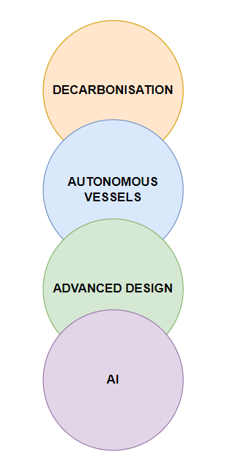
  Opportunities to work all over the world
  A very active and established Industry with high potential developing subfields
  Mandatory to worldwide trade
  Exceptional opportunities and compensation
  New challenges futureproof the need for Naval Architects for many years
  Highly innovative field
A FIELD WITH A FUTURE
Notes:
Challenges and innovations in
Decarbonisation
Autonomy
Advanced design
AI
Guarantee future work for many years

Slide 20

Q&A

